Slide 1
“CONSTRAINED DYNAMIC OPTIMIZATION”
Moving penalty methods
By
Amir Ali

Slide 2
Problem statement
Assuming we have considered a process described by the following:
x_{n+1} = f_{n} (x_{n}; u_{n})
J = ΣX ^{N-1}_{n=0} L_{n}(x_{n}; u_{n})
x_{n} – k {dimensional state vector in a time moment n,
u_{n} – r {dimensional control vector in a time moment n,
N - optimization horizon,
L_{n} - partial cost function.

Slide 3
Moving penalty functional
The algorithm may be summarized in the following steps:
Define the modified penalty functional J.
Choose the values for the following coefficients:
Substitution and initialization
Find initial the solution minimizing state equation.
Apply stopping criteria followed by subsequent calculation

Slide 4
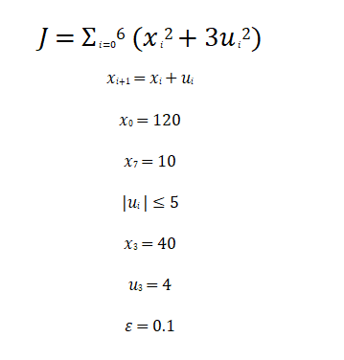
Problem
Here it is asked to solve this constrained optimization problem using moving penalty function

Slide 5
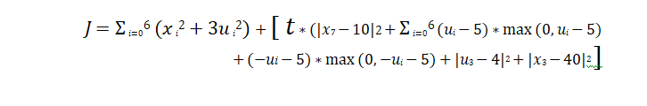
…
Modified J function using penalty functions

Slide 6
Parameterization Implemented
This optimization problem has got something not right with the constraints mentioned.
Stopping criteria ends the algorithm without some constraints not being satisfied because of minimizing of the cost function J (Performance index) and weighting the violation of constraints.

Slide 7
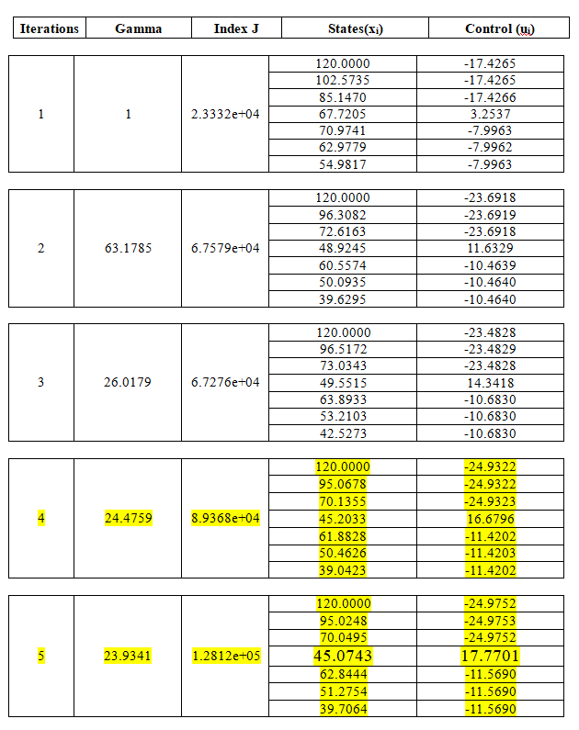

Slide 8
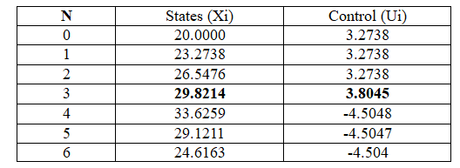
The problem with weak constraints
Achieved and meets almost all constraints without violation.
Better results when the problem is set to be without strong equality constraint.
Stopping criteria ends the algorithm with all constraints being satisfied.
Eventually with this change the optimization ends at 4th iteration with 𝛾 = 0.2505 and performance index 𝐽 = 5.2785e+03.

Slide 9
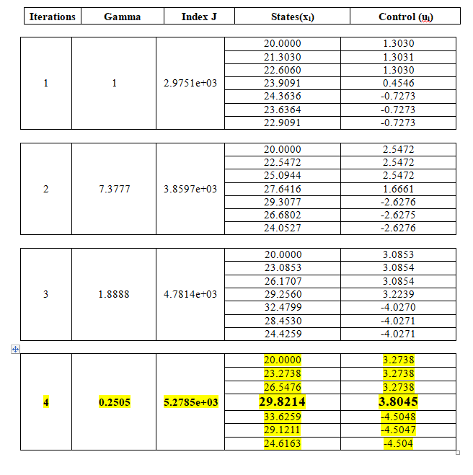

Slide 10
Conclusion
The aim of this project is to implement constrained dynamic optimization algorithm with usage of penalty methods as the goal is to achieve a global minimum of a performance index by satisfying the constraint. The Penalty function keeps the algorithm checking every possible solution but not to get stuck in local minimum.

Slide 11
Thank You ☺

